Slide 1
Sign-Language Recognition Using Machine Learning
G kiran kumar (318126510139)
M Sumanth (318126510155)
E V M Prateek (318126510138)
Azharuddin (318126510174)
Charan Reddy (317126510106)
Guided By
Dr. V Usha Bala
REVIEW 2

Slide 2

A Quick Recap…
There is a problem when mute people try to communicate with people who do not know sign language. We suggest a solution to this problem using ML based translator that can identify Indian sign language and translate to English.

Slide 3
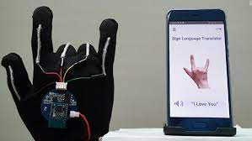
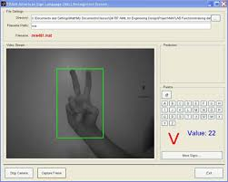
Existing System
There are a few sign language translation systems
Sensor Gloves
Accurate
Easy to use
Costly
Algorithms to recognise signs
Cost effective
Uses color gloves sometimes to increase Accuracy
Less accuracy for multi handed signs

Slide 4
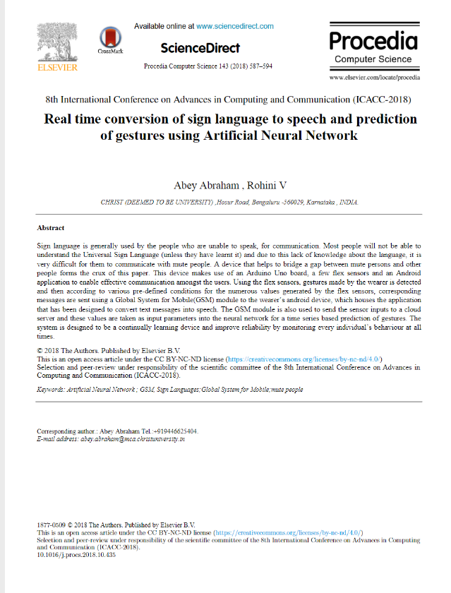
Reference paper
A Hardware Based Solution
Working yet complex
Advantages
Easy to use
Gives accurate results
Disadvantages
Feasibility is less
Context is missing

Slide 5
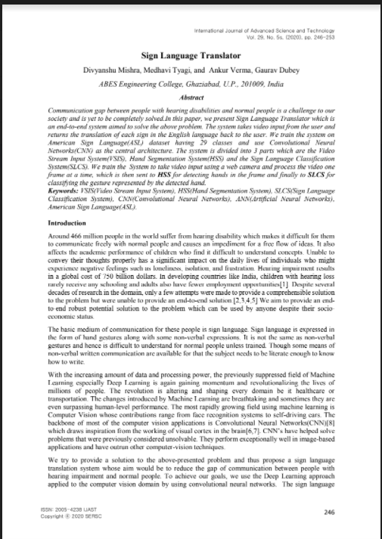
Implementation Reference
A Software based approach
Advantages
Easy to use
Economical and feasible
Disadvantages
Deployment is complex

Slide 6

Proposed System
We propose to use Machine learning algorithms to recognise the Gestures and signs in Indian sign language.
We train the Machine learning model to recognise signs and gestures in indian sign language.
We will send the words identified to a sentence generator algorithm to make a proper english sentence with the generated words.
Finally the generated output will be shown on screen and played out-loud using the device speaker.

Slide 7
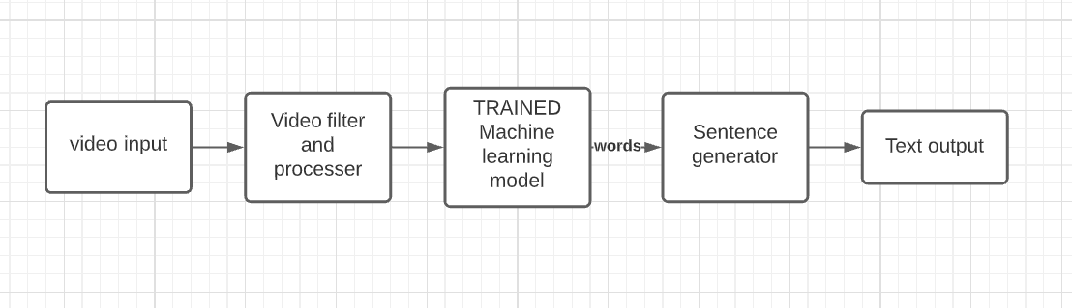

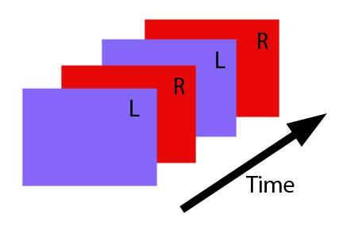

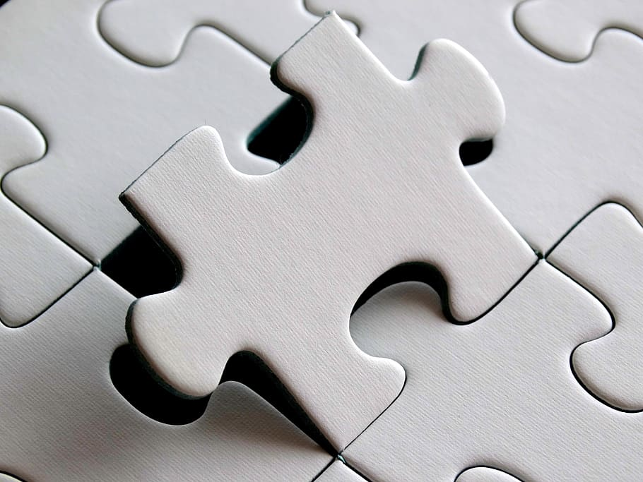
System Architecture
I am Kiran

Slide 8
System Architecture
Video Input is taken as input and each frame is taken out of the video.
The Video filter and processor labels the hand gestures in the frames.
These labelled frames are then sent to the learning model.
This model now gets trained by the sent data.
After the gestures are recognised, they’re sent to sentence generator.
The Sentence generator takes the text and phrases the sentence, words accordingly for understandable output to the user.
This output of the Sentence generator is shown as Output which is an understandable sentence.

Slide 9
Literature Survey
Research on Previous systems
No Real time Live translation system
No identification of gestures
Less accuracy and less sign space
No High level conversion

Slide 10
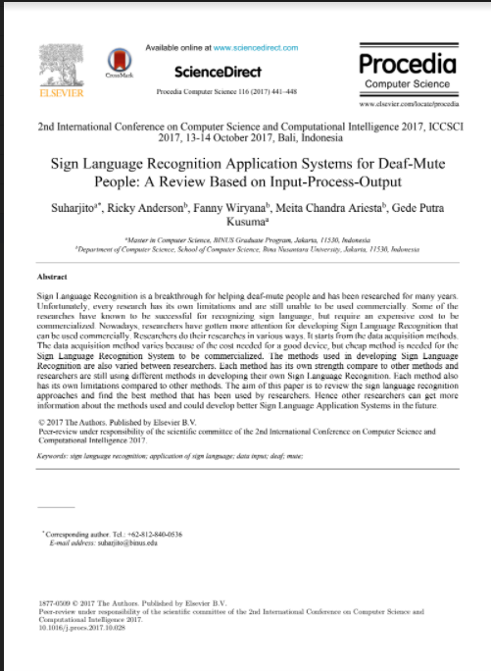
Literature Survey Continued
Accuracy analysis
Difficulties in data Acquisition
Drawbacks of Hardware and software systems
Analysis of different data Acquisition methods
Accuracy analysis of different algorithms

Slide 11
Literature survey Challenges
Challenges Faced
No standard Dataset available
No feasible Model till date

Slide 12
Literature survey Conclusions
Explored different Algorithms
Convolution Neural Network (1)
Optical flow Recognition (2)
Key frame Extraction (3)
Other Conclusions
Decided to prepare own dataset
Including face gestures improves context while translating
Decomposition of System is important

Slide 13
Workflow
Implementing object detection for accuracy analysis, Algorithm selection (image dataset)
Phase 1
Including Face gestures and training using video data (10 words)
Phase 2
Training complete model (100 words)Implementing Natural language processing algorithm for sentence generation
Phase 3

Slide 14
Dataset Overview
Phase 1
We choose Image dataset
Reason is working with video data is tedious
Including both single and double hand gestures
Image dataset both hands
image dataset single hands
Phase 2
Migrating to video data (10 Gestures)
Exploring other video algorithms

Slide 15
Dataset Overview Continued
Phase 3
Completing video data(100 gestures)
Obtaining data to training Sentence generator

Slide 16
Convolution Neural Networks
Training with video data and Extracting Features
Each sign having a certain interval and Automatically detected from input video stream
Input
Trained model
Recognised Gesture
Live captured video data
Trained using video Dataset
Words based on training data

Slide 17
Optical Flow
Idea is to identify the flow of objects in the video (Hand movements)
Convert these movements into Tensors and Train the model using these abelled tensors
Input
Trained model
Recognised Gesture
Live captured video data as movement tensors
Trained on the tensors for different gestures using video Dataset
Words based on tensor class identified

Slide 18
Key Frame Extraction
Each Sign is a Combination of different Gestures called key frames
Idea in key frame extraction is to extract these frames and make a dictionary for each sign and identifying the mapping while recognizing
Input
Trained model
Recognised Gesture
Live captured video data
Trained to identify the change in direction of object
Words based on training data

Slide 19
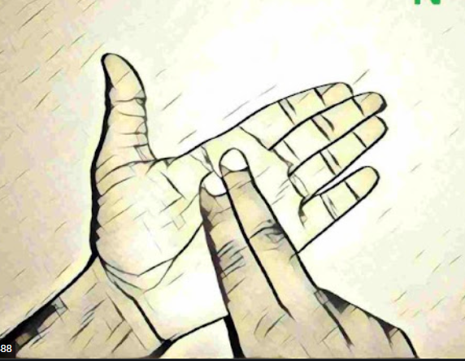
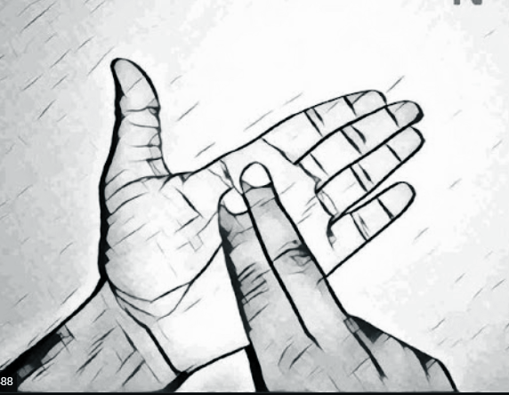
Sample Input
Phase 1
MODEL
MODEL

Slide 20


Sample Input
Phase 2
MODEL
MODEL

Slide 21

Sample Input
Phase 3
MODEL
MODEL

Slide 22
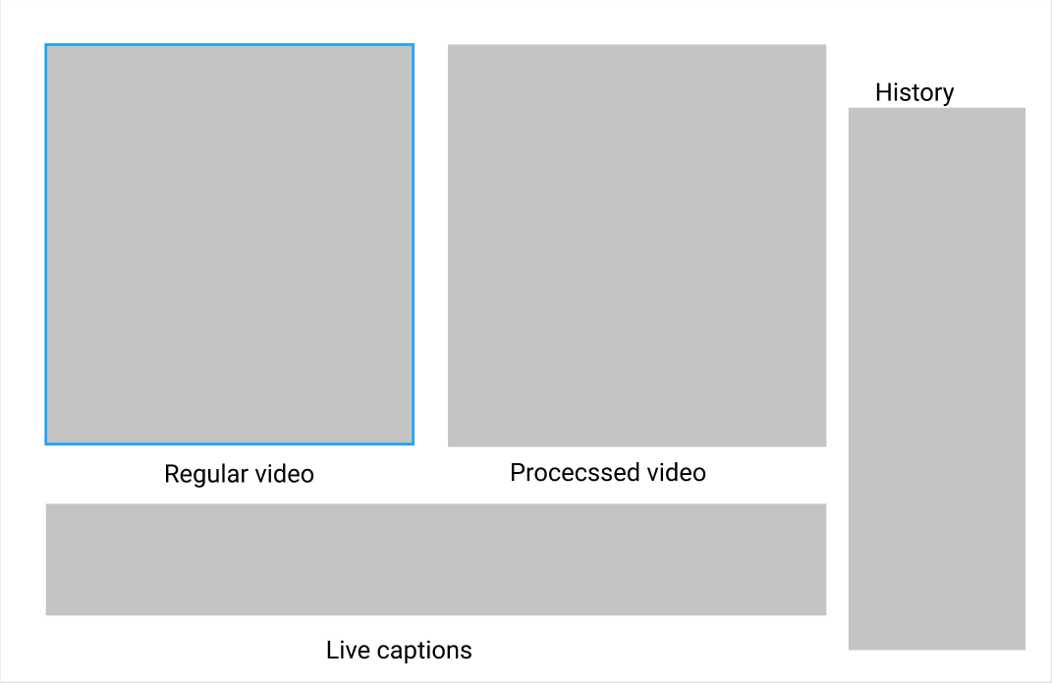
Sample Output
HI
HI

Slide 23
References
Research Papers
Accuracy analysis paper
Project Idea paper
Implementation inspiration paper
https://drive.google.com/file/d/1gOO20k-eyH7GtNm1PfjSQ5wXD9w6_5kD/view?usp=sharing
https://drive.google.com/file/d/1EIQ-XWRxuzSEGoclHD1yBYRLzSeUpB18/view?usp=sharing
https://drive.google.com/file/d/14sdlBv7UYz2qbprNgnMNL1QyvZBZFyXU/view?usp=sharing

Slide 24
References
Documentation , words selected
project details
Project documentation
Official Sign translation and dictionary
https://indiansignlanguage.org/
http://www.islrtc.nic.in/

Slide 25
Thank you for your time.

